Slide 1

Colleges Race to Ready Students for the AI Workplace
Week 15 Ed Elowson Higher Education

Slide 2

Link To The Source
https://www.wsj.com/us-news/education/colleges-race-to-ready-students-for-the-ai-workplace-cc936e5b

Slide 3
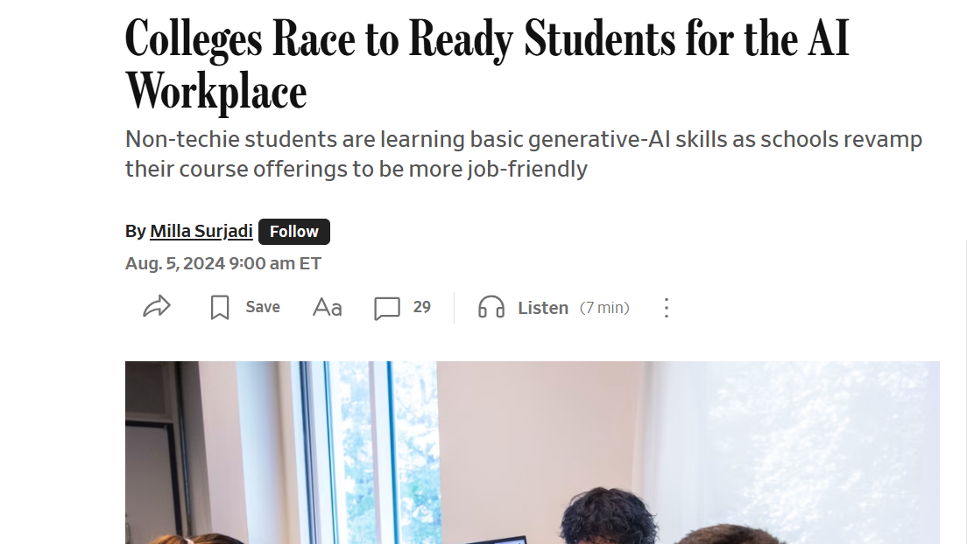
Screenshot

Slide 4

Main Findings
The article explains how colleges and universities are rapidly restructuring programs and coursework to prepare students for an AI-driven workforce. As generative AI tools like ChatGPT become increasingly common in professional environments, students are seeking AI-related skills to improve employability and remain competitive in the job market. Universities such as Emory, Cornell, the University of Florida, and USC are responding by creating AI minors, certificates, and specialized degrees that combine technical training with real-world applications across business, marketing, engineering, and other disciplines. The article highlights that employer demand for AI literacy is growing quickly, with job postings mentioning generative AI tools tripling over the past year. Educators compare AI literacy to learning Microsoft Office or typing in earlier decades, suggesting it will soon become a universal workplace expectation. At the same time, universities are emphasizing ethical concerns, critical thinking, and understanding AI’s limitations alongside technical skills.

Slide 5
Broader Implications for Society
The broader societal implications reflect a major shift in education, workforce development, and the future of knowledge work. AI is increasingly viewed not as a niche technical specialty but as a foundational skill needed across nearly every profession. This transition could improve productivity, innovation, and economic competitiveness, but it also creates pressure on schools, businesses, and governments to adapt quickly. The article suggests that higher education institutions are becoming responsible for preparing students not only to use AI tools, but also to critically evaluate their outputs and understand ethical risks such as misinformation, bias, and overreliance on automation. At a societal level, the rapid integration of AI into education may widen skill gaps between workers who are AI-literate and those who are not. It also raises broader questions about the long-term value of traditional degrees, how quickly universities can evolve with emerging technologies, and whether educational systems can keep pace with the speed of AI development.

Slide 6
Relevance and Potential Influence on The Construction Industry
For the construction industry, the rise of AI-focused education could significantly influence the future workforce and accelerate digital transformation across architecture, engineering, construction, and facilities management. As universities produce graduates with AI literacy and technical skills, construction firms may increasingly adopt AI-powered tools for scheduling, estimating, procurement, safety monitoring, BIM coordination, predictive maintenance, and project analytics. Future professionals entering the industry may be better prepared to use AI to improve productivity, reduce project delays, and optimize decision-making in complex construction environments. The article’s emphasis on interdisciplinary AI education is especially relevant because construction increasingly relies on collaboration between technical, managerial, and operational teams. Additionally, as labor shortages and infrastructure demands continue to grow, AI-trained graduates could help modernize traditionally manual workflows and support more data-driven project delivery. However, the industry will also need to address challenges involving workforce retraining, ethical AI use, cybersecurity, and ensuring that human expertise remains central in safety-critical construction decisions.

Slide 7
